Slide 1
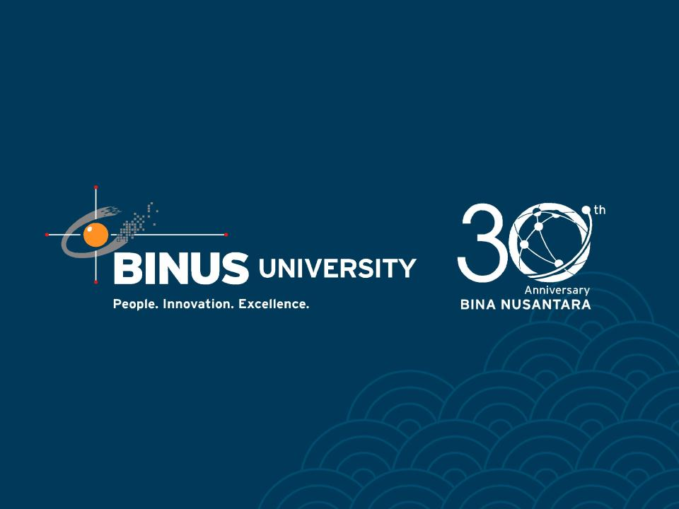

Slide 2
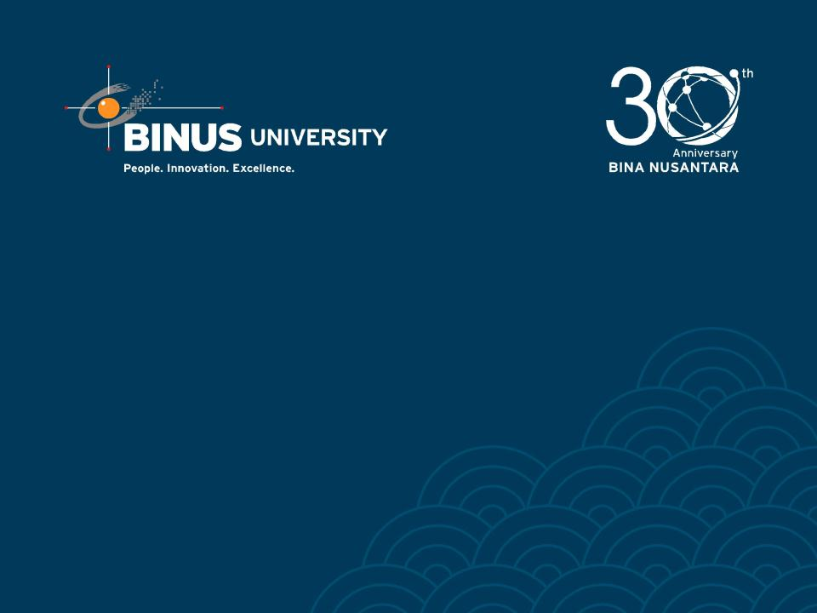
Course : T1192 – Game Design
Year : 2012
Game Balancing
Meeting 11
Bina Nusantara University

Slide 3
Outline Material
Introduction
Game balancing methodology
Balancing game economics
Dynamic game balancing
Making PvP games fair
Making PvE games fair
Case Study
Bina Nusantara University

Slide 4
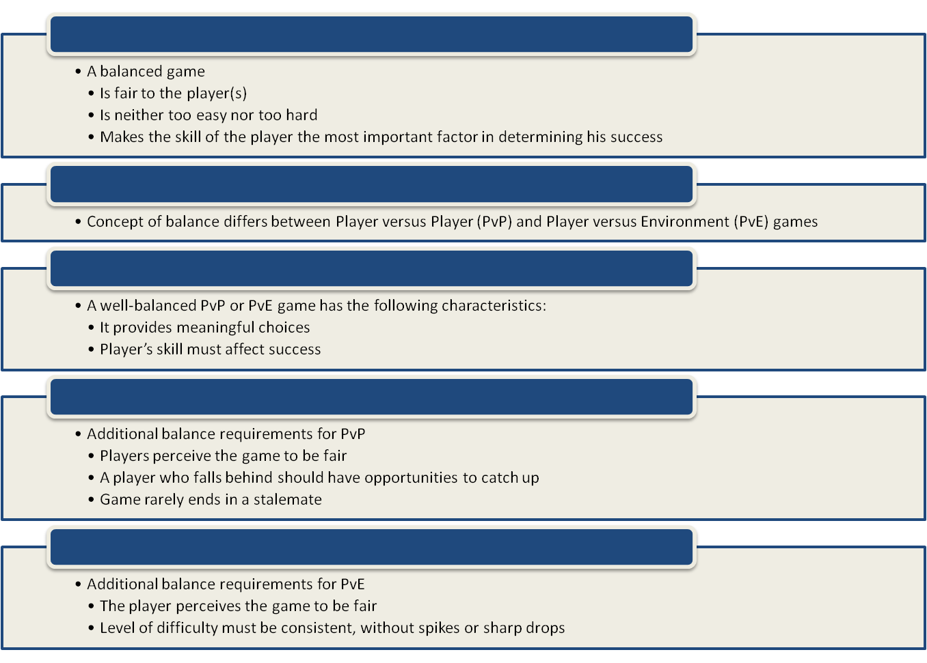
Introduction

Slide 5
Game balancing methodology
Balance Type #1: Fairness
  Symmetrical Games
  Asymmetrical Games
  Rock, Paper, Scissors
Balance Type #2: Challenge vs. Success
  Increase difficulty with each success.
  Let players get through easy parts fast.
  Create “layers of challenge. ”
  Let players choose the difficulty level.
  Playtest with a variety of players.
Balance Type #3: Meaningful Choices
  Low risk/low reward, High risk/ high reward
Balancing Type #4: Skill vs. Chance
Balancing Type #5: Head vs. Hands
Bina Nusantara University

Slide 6
Game balancing methodology
Balance Type #6: Competition vs. Cooperation
Balance Type #7: Short vs. Long
Balance Type #8: Rewards
Balance Type #9: Punishment
  Punishment creates endogenous value
  Taking risks is exciting
  Possible punishment increases challenge
Balance Type #10: Freedom vs. Controlled Experience
Balance Type #11: Simple vs. Complex
  Innate complexity
  Emergent complexity
Balance Type #12: Detail vs. Imagination
  Only detail what you can do well
  Give details the imagination can use
  Familiar worlds do not need much detail.
  Use the binocular effect
  Give details that inspire imagination
Bina Nusantara University

Slide 7
Balancing game economics
Fairness: Do any players get unfair advantage by buying certain things, or earning a certain way?
Challenge: Can players buy something that makes the game too easy for them? Is earning money to buy what they want too hard?
Choices: Do players have enough ways to earn money? To spend money?
Chance: Is earning money more skill-based or chance-based?
Cooperation: Can players pool their funds in interesting ways? Can they collude in a way that exploits “holes” in the economy?
Time: Does it take too long to earn money, or is it earned too quickly?
Rewards: Is it rewarding to earn money? To spend money?
Punishment: How do punishments affect a player’s ability to earn and spend money?
Freedom: Can players buy what they want, and earn the way they want?
Bina Nusantara University

Slide 8
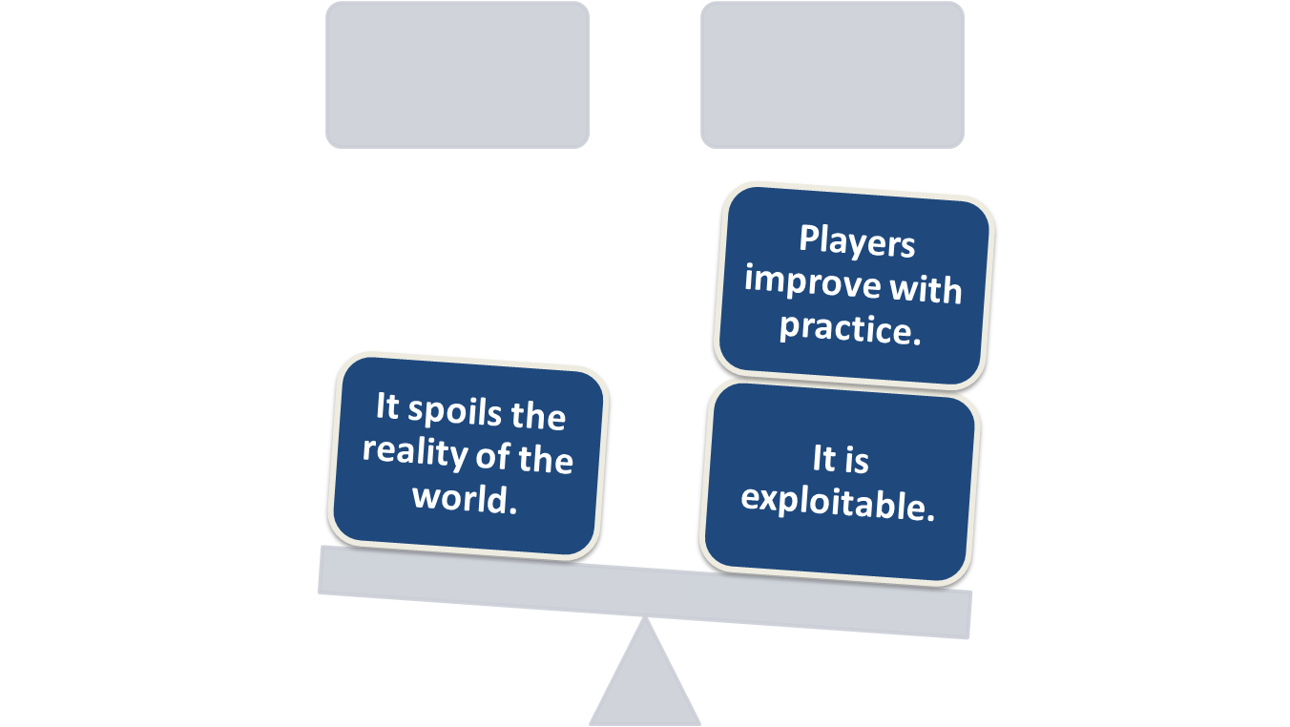
Dynamic game balancing
Bina Nusantara University

Slide 9
Making PvP games fair
To balance symmetric games, treat every player the same
  Same rules, resources, victory conditions
Asymmetric games are harder to balance
  One approach: give players identical quantities of materials or points when they start
    Players spend points to build units as they wish
    Players spend ponts to adjust unit attributes
Study Starcraft as a great asymmetric game
Balance issues for persistent worlds
  Persistent worlds are never symmetric and always intrinsically unbalanced
  New players need protection
  Can be rebalanced on the fly by patching
Bina Nusantara University

Slide 10
Making PvE games fair
A fair PvE game should
  Offer challenges at a consistent level of difficulty
  Avoid learn-by-dying designs
  Avoid stalemates
  Provide information for critical decisions
  Avoid requiring extrinsic information
  Include challenges appropriate for the genre
Bina Nusantara University

Slide 11

Case Study
Make a group of six
Make a game design including 12 game balancing methods!
Bina Nusantara University

